Slide 1

Module on
Automated state-based testing
RISE Research Institutes of Sweden

Slide 2
Building blocks the capsule
Introduction
Unit tests with JUNIT
Activity 1: Test ThreePlayerGame
State Models, code instrumentation and test generation
Activity 2: Review generated tests
Test Evaluation

Slide 3
Software Testing – Introduction (Motivation)
60
Assume $1000 unit cost, per fault, 100 faults
$250K
50
$360K
40
Fault detection (%)
Unit cost (X)
30
$20K
$100K
20
$13K
10
$6K
0
Requirements
Design
Prog / Unit Test
Integration Test
System Test
Post-Deployment
Software Engineering Institute; Carnegie Mellon University; Handbook CMU/SEI-96-HB-002
Notes:
Clearly talk about this diagram…

Slide 4


Software Testing – Introduction
“Testing is the process of establishing confidence that a program or system does what it is supposed to” - Hetzel, 1973
Test Design Approach
Software
Test cases
Notes:
Can be seen as functions that, based on a set of rules, generate test cases from software artifacts (e.g., specifications or code)

Slide 5
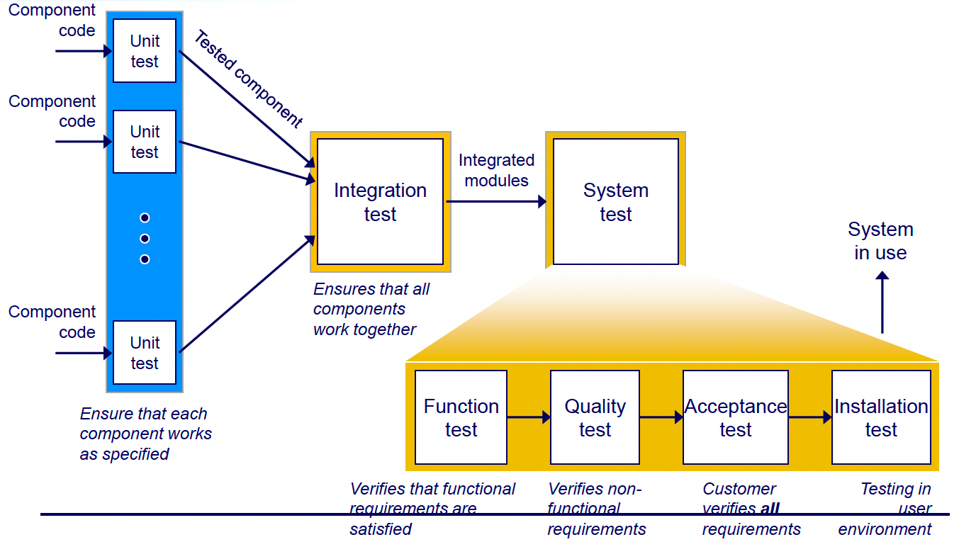



Nature of test design approaches
Inputs and Expected outcomes
Internal working of the code
Black-box + limited internal knowledge

Slide 6
Example test
Arrange
Act
Assert
Scenario | Test name | Pre-conditions | Steps | Data | Expected Results | Actual Results | Pass/Fail
Check sum | Check sum for 2 positive numbers | N/A | - Initiate calculator – pass two numbers to sum() | 2 and 2 | 4 | 4.0 | Fail
public class Calculator {
public float sum(float a, float b)
return a+b;
}

Slide 7
Example test in code
import SUT.Calculator;
public class UnitTests {
Calculator sut;
//Check sum for 2 positive numbers
public boolean checkSum() {
sut= new Calculator();
float r=sut.sum(2,2);
if(r==4)
return true;
return false;
}
}
Arrange
Act
Assert

Slide 8
JUnit basics

Slide 9
Background on xUnit
First xUnit framework developed: for Smalltalk in in 90s by Kent Beck
Why?: To make it easy to arrange, act and assert. With additional perks on results visualization and repeatable cross-platform tests.
Junit:
Annotations and assertion for better test management: @Test, @Test(timeout=1000), @Before, assertTrue()…
Test Runner, and Test Suite to manage test dependency and group tests
Better visualization (coverage and Junit test Results)

Slide 10
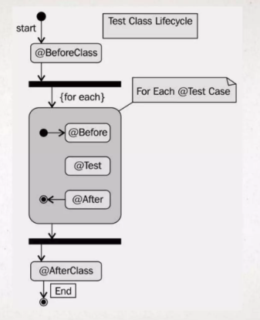
Junit annotations flow

Slide 11
Junit Assertions
Boolean
assretEquals( bool expected, bool actual)
assertTrue/False(bool condition)
Reference
assertSame/assertNotSame(ref1, ref2)
Array
assertArrayEquals(array1, array2)
assertNull/assertNotNull(Object obj)

Slide 12
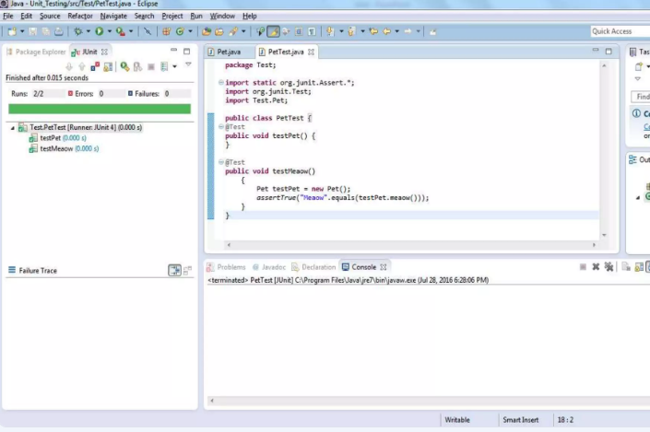
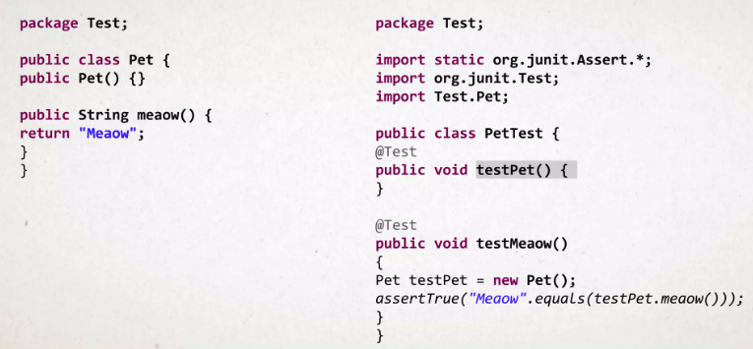
Example @Test and Assert

Slide 13
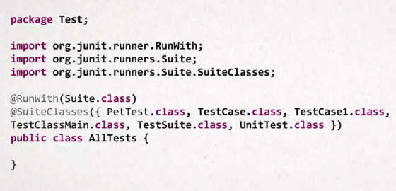
Example Test suite

Slide 14
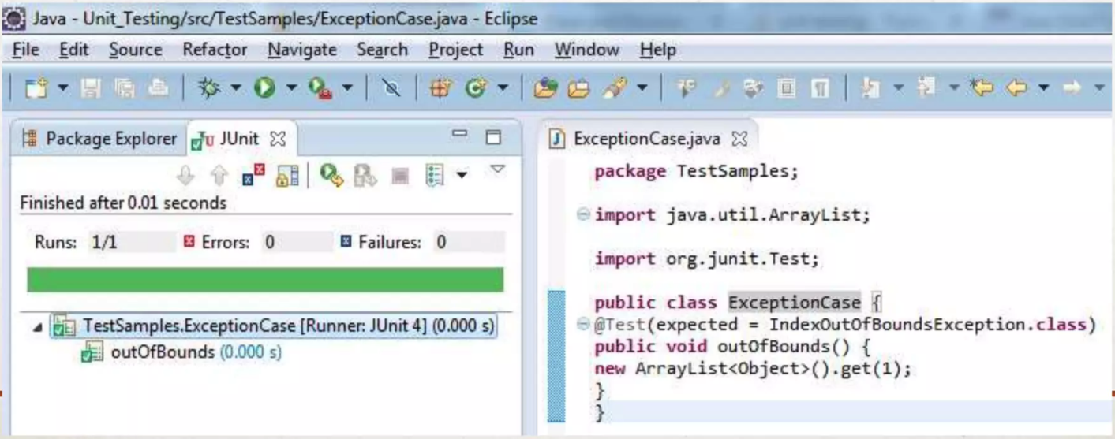
Testing Exceptions

Slide 15
System under test (SUT)

Slide 16
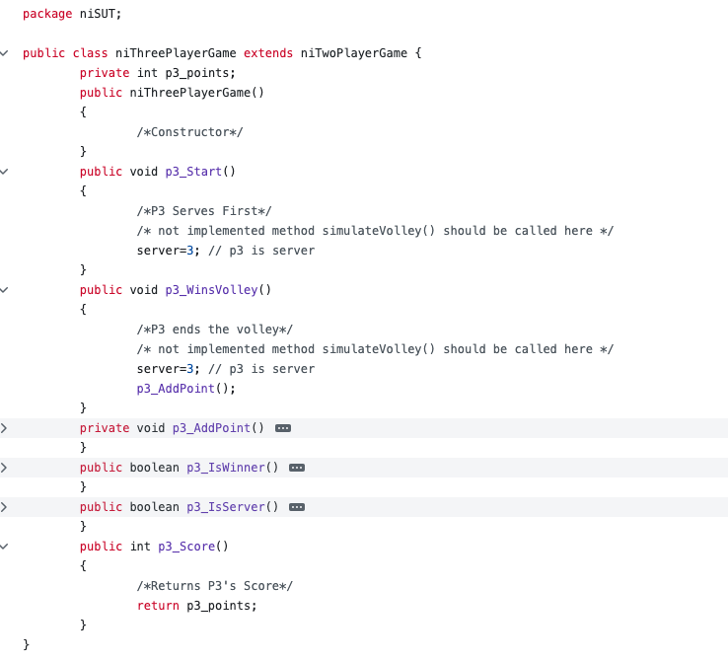
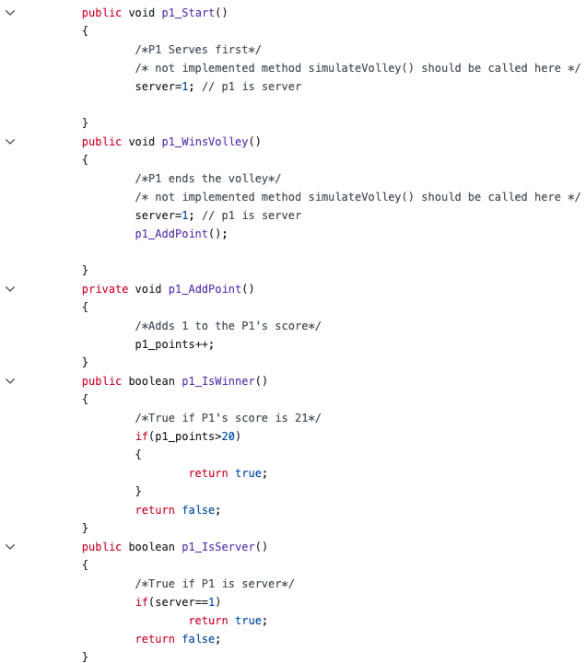
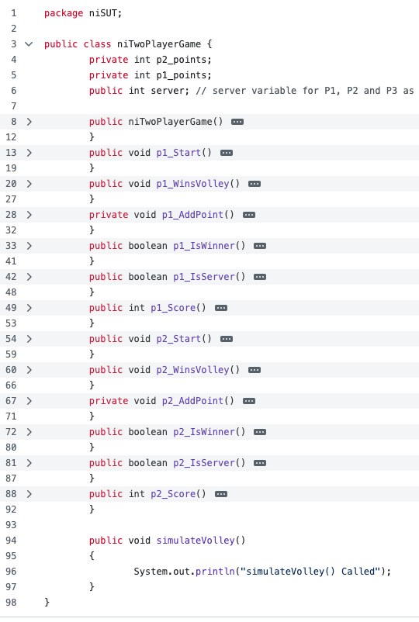
SUT: 3 Player Volley Game Back-end
Serving: The game starts with a serve by one of the players. The server is determined by a random draw or agreement among the players.
Gameplay: Players take turns on serving the ball, given that they win a volley.
Scoring: A point is scored when a player wins the volley. The score is maintained for all of the three players involved. The first player to reach a predetermined number of points (21) wins the game.

Slide 17
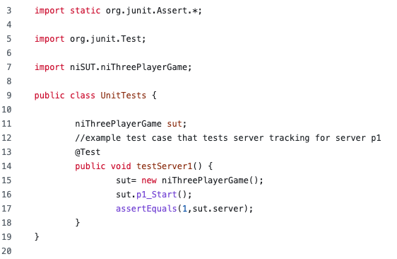
Example test
Serving: The game starts with a serve by one of the players. The server is determined by a random draw or agreement among the players.

Slide 18

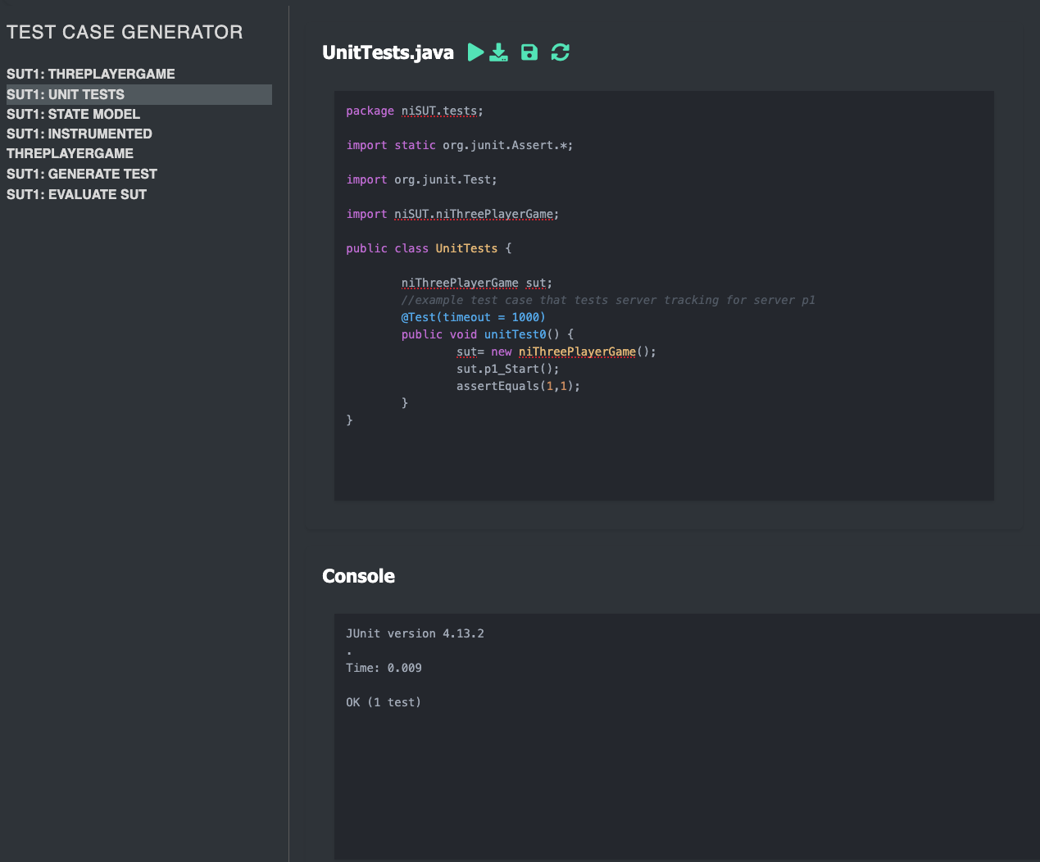
Activity 1
Write and submit Junit4 unit tests for the ThreePlayerGame class and its inherited methods.
Serving: The game starts with a serve by one of the players. The server is determined by a random draw or agreement among the players.
Gameplay: Players take turns on serving the ball, given that they win a volley.
Scoring: A point is scored when a player wins the volley. The score is maintained for all of the three players involved. The first player to reach a predetermined number of points (21) wins the game.

Slide 19
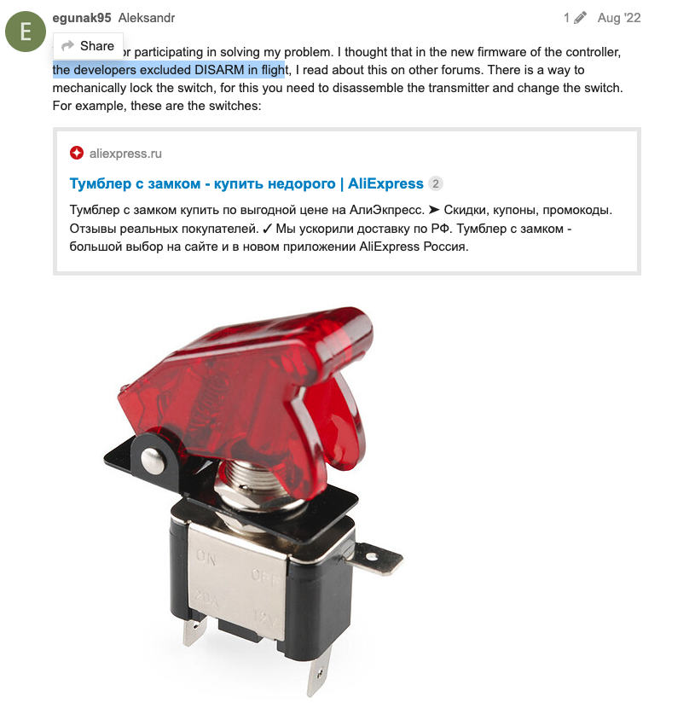

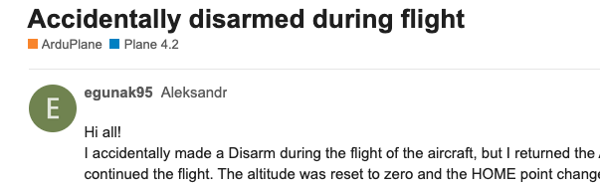

State-based testing (Motivation)

Slide 20
State-based modelling & testing

Slide 21

Motivation
We are interested in testing the behaviour of many different types of systems, including event-driven software systems
Interaction with GUI systems can follow a large number of paths
State machines can model event-driven behaviour
If we can express the system under test as a state machine, we can generate test cases for its behaviour

Slide 22

What is a state machine…
A system whose output is determined by both current state and past input
Previous inputs are represented in the current state
State-based behaviour
Identical inputs are not always accepted
Depends upon the state
When accepted, they may produce different outputs
Depends upon the state

Slide 23
Building blocks of a state machine
State
An abstraction that summarizes past inputs, and determines behaviour on subsequent inputs
Transition
An allowable two-state sequence. Caused by an event
Event
An input or a time interval
Action
The output that follows an event

Slide 24
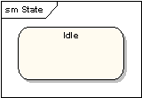
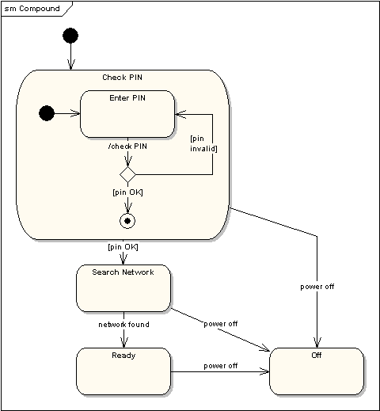
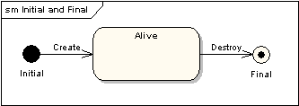
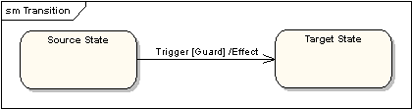
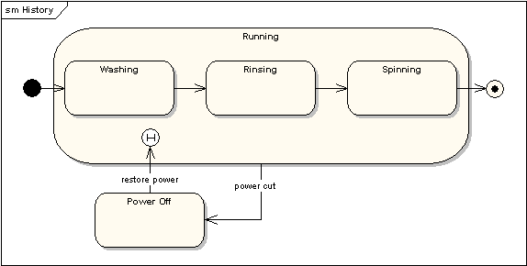
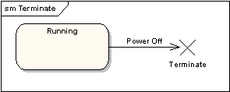
State machines

Slide 25
State machine – a behavioral model
Begin in the initial state
Wait for an event
An event comes in
If not accepted in the current state, ignore
If accepted, a transition fires, output is produced (if any), the resultant state of the transition becomes the current state
4. Repeat from step 2 unless the current state is the final state
Notes:
State machine properties
■ How events are generated is not part of the model
■ Transitions fire one at a time
■ The machine can be in only one state at a time
■ The current state cannot change except by a defined
transition
■ States, events, transitions, actions cannot be added during
execution

Slide 26
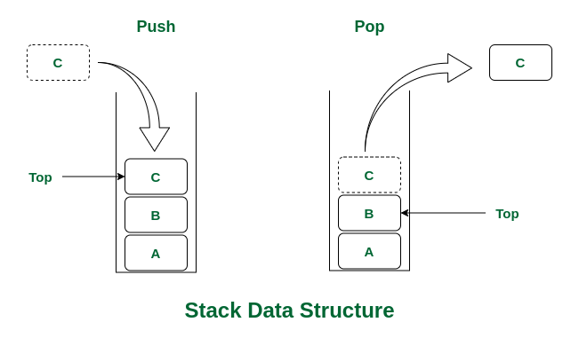
State Transition Diagram
This model is ambiguous, e.g. there are two possible reactions to push and pop in the Loaded state
Guards can be added to transitions
A guard is a predicate associated with the event
A guarded transition cannot fire unless the guard predicate evaluates to true
Empty
pop/ EmptyStackException
push(x)
pop/
return top(x)
Loaded
pop/ return top(x)
push(x)
push(x)
pop/
return top(x)
Full
push(x)/ FullStackException

Slide 27
State Transition Diagram with guards
Empty
pop/ EmptyStackException
push(x)
pop /
return top(x)
[n==1]
Loaded
pop / return top(x)
push(x)
[n>1]
[n < max-1]
push(x)
pop/
return top(x)
[n == max-1]
Full
push(x)/ FullStackException
Notes:
Stack picture

Slide 28
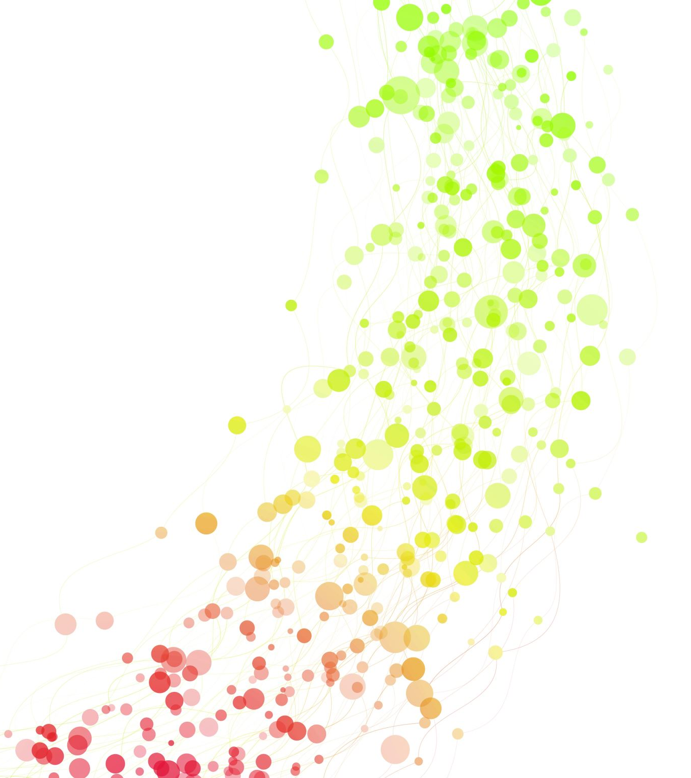
Coverage
Exhaustive
All Transitions/state
Every transition executed at least once
N-wise Transition
All n-transition sequences
All round trip paths
All guards
Exercise guards in negation and in satisfaction
Sneak paths (corrupt states)
Exercise all illegal paths
Empty
pop/ EmptyStackException
push(x)
pop /
return top(x)
[n==1]
Loaded
pop / return top(x)
push(x)
[n>1]
[n < max-1]
push(x)
pop/
return top(x)
[n == max-1]
Full
push(x)/ FullStackException

Slide 29

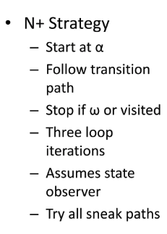
Coverage: N+ Strategy

Slide 30

N+ Strategy
1. ()
2.pop/EmptyStackException
3. push(x)
4. pop [n==1] / return top(x)
Empty
5. pop [n>1] / return top(x)
Empty
pop/ EmptyStack Exception
6. push(x) [n < max-1]
7. push(x) [n == max-1]
4
push(x)
5*
Loaded
pop /
return top(x)
[n==1]
Loaded
3
6*
Loaded
Loaded
pop / return top(x)
push(x)
[n>1]
alpha
1
Empty
Full
[n < max-1]
7*
8*
push(x)
pop/
return top(x)
2*
Full
[n == max-1]
Empty
Full
push(x)/ FullStack Exception
9
Loaded
8. push(x)/FullStackException
9. pop/return top(x)
Notes:
■ Limited scalability
■ Even with the best tools available, diagrams with 20 states
or more are unreadable
■ Concurrency cannot be modeled
■ Different processes can be modeled with different state
machines, but the interactions between them cannot
■ Not specific enough for Object-Oriented systems

Slide 31
N+ Conformance Tests
1. ()
2.pop/EmptyStackException
3. push(x)
1. ()
4. pop [n==1] / return top(x)
Check we are in “Empty” State
2.pop/EmptyStackException
5. pop [n>1] / return top(x)
Empty
Catch “EmptyStackException”
6. push(x) [n < max-1]
4
Check we are in “Empty” State
7. push(x) [n == max-1]
~()
5*
Loaded
1. ()
Loaded
Check we are in “Empty” State
3. push(x)
3
6*
Check we are in “Loaded” State
1
Loaded
4. pop [n==1] / return top(x)
alpha
Empty
8*
Full
Check we are in “Empty” State
7*
3. push(x)
2*
Full
Check we are in “Loaded” State
Empty
GUARD: [n>1] ?
9
3. push(x)
5. pop [n>1] / return top(x)
Loaded
8. push(x)/FullStackException
Check we are in “Loaded” State
9. pop/return top(x)
Manual review (True to life)
~()
Notes:
■ Limited scalability
■ Even with the best tools available, diagrams with 20 states
or more are unreadable
■ Concurrency cannot be modeled
■ Different processes can be modeled with different state
machines, but the interactions between them cannot
■ Not specific enough for Object-Oriented systems

Slide 32
N+ Conformance Test (in JUnit)
5
import SUT.Stack;
public class UnitTests {
Stack sut;
int x;
int max;
@Test
public void testPath01() {
max=5;
sut= new Stack(max);
x=10;
sut.push(x);
assertTrue(sut.isLoaded());
//Check [n==1]
//while(sut.getLength()!=1)
//sut.push(x)
sut.pop();
assertTrue(sut.isEmpty());
}
}
1. ()
Check we are in “Empty” State
10
3. push(x)
Check we are in “Loaded” State
4. pop [n==1] / return top(x)
Check we are in “Empty” State
Abstract
Notes:
■ Limited scalability
■ Even with the best tools available, diagrams with 20 states
or more are unreadable
■ Concurrency cannot be modeled
■ Different processes can be modeled with different state
machines, but the interactions between them cannot
■ Not specific enough for Object-Oriented systems

Slide 33
Sneak paths
Conformance tests -> tests explicit behaviour
We need to test each state’s illegal events
Tests for each non-checked, non-excluded transition
Confirm that the actual response matches the specified response [Manual review]

Slide 34
N+ Sneak Paths Tests
1. ()
2.pop/
EmptyStackException
3. push(x)
1. ()
4. pop [n==1] / return top(x)
“Empty”
5. pop [n>1] / return top(x)
Empty
[has child] Do everything but “3 & 2”
6. push(x) [n < max-1]
7. push(x) [n == max-1]
4
Exceptions but still in “Empty”
5*
Loaded
3. push(x)
Loaded
“Loaded”
[has child]
Do everything but “4, 5, 6, & 7”
3
6*
1
Loaded
Exceptions but still in “Loaded”
alpha
Empty
8*
Full
7*
4. pop [n==1] / return top(x)
2*
Full
[has child]
STOP
Empty
9
FullStackException
Loaded
8. push(x)/
Manual review (True to life)
9. pop/return top(x)
Notes:
■ Limited scalability
■ Even with the best tools available, diagrams with 20 states
or more are unreadable
■ Concurrency cannot be modeled
■ Different processes can be modeled with different state
machines, but the interactions between them cannot
■ Not specific enough for Object-Oriented systems

Slide 35
State-based testing of SUT

Slide 36
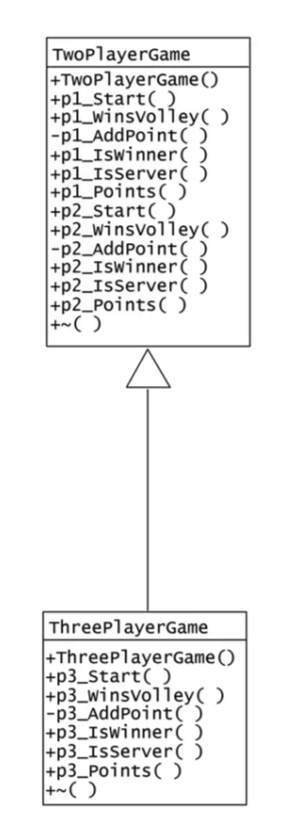
Modelling SUT
TwoPlayerGame
TwoPlayerGame()
Game Started
p1_Start()/ simulateVolley()
p2_Start()/ simulateVolley()
p1_WinsVolley()/ simulateVolley()
p1_WinsVolley() [this.p1_Score<20]/ this.p1AddPoint()
simulateVolley()
p1_WinsVolley() [this.p1_Score<20]/ this.p1AddPoint()
simulateVolley()
Player 1 Served
Player 2 Served
p2_WinsVolley()/ simulateVolley()
p1_WinsVolley() [this.p1_Score==20]/ this.p1AddPoint()
p2_WinsVolley() [this.p2_Score==20]/ this.p2AddPoint()
Player 1 Won
Player 2 Won
p1_IsWinner()/ return TRUE;
p2_IsWinner()/ return TRUE;
~()
~()
ω

Slide 37
Modelling SUT
ThreePlayerGame
ThreePlayerGame()/TwoPlayerGame()
Game Started
p3_WinsVolley()/ simulateVolley()
p3_Start()/ simulateVolley()
p1_WinsVolley()/ simulateVolley()
p3_WinsVolley() [this.p3_Score<20]/ this.p3AddPoint()
simulateVolley()
TwoPlayerGame
Player 3 Served
p2_WinsVolley()/ simulateVolley()
p3_WinsVolley() [this.p3_Score==20]/ this.p3AddPoint()
Player 3 Won
p3_IsWinner()/ return TRUE;
ω
~()

Slide 38
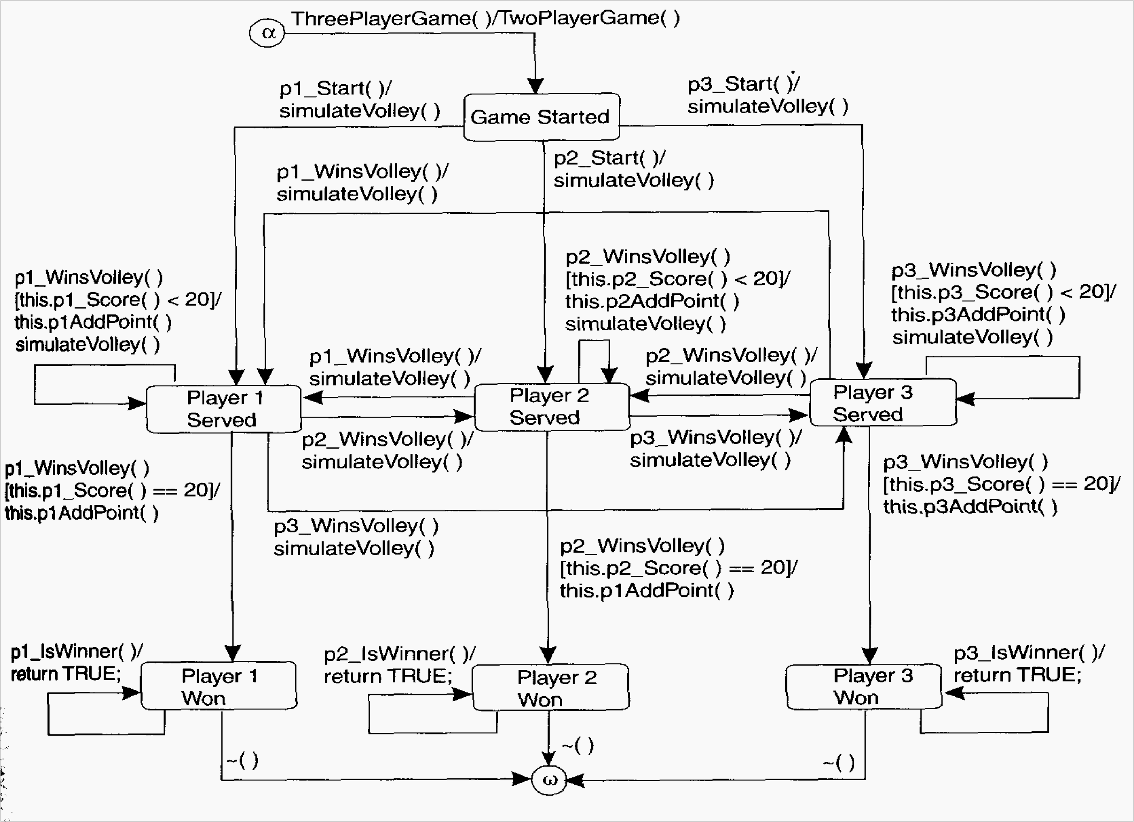
Test Ready Model

Slide 39
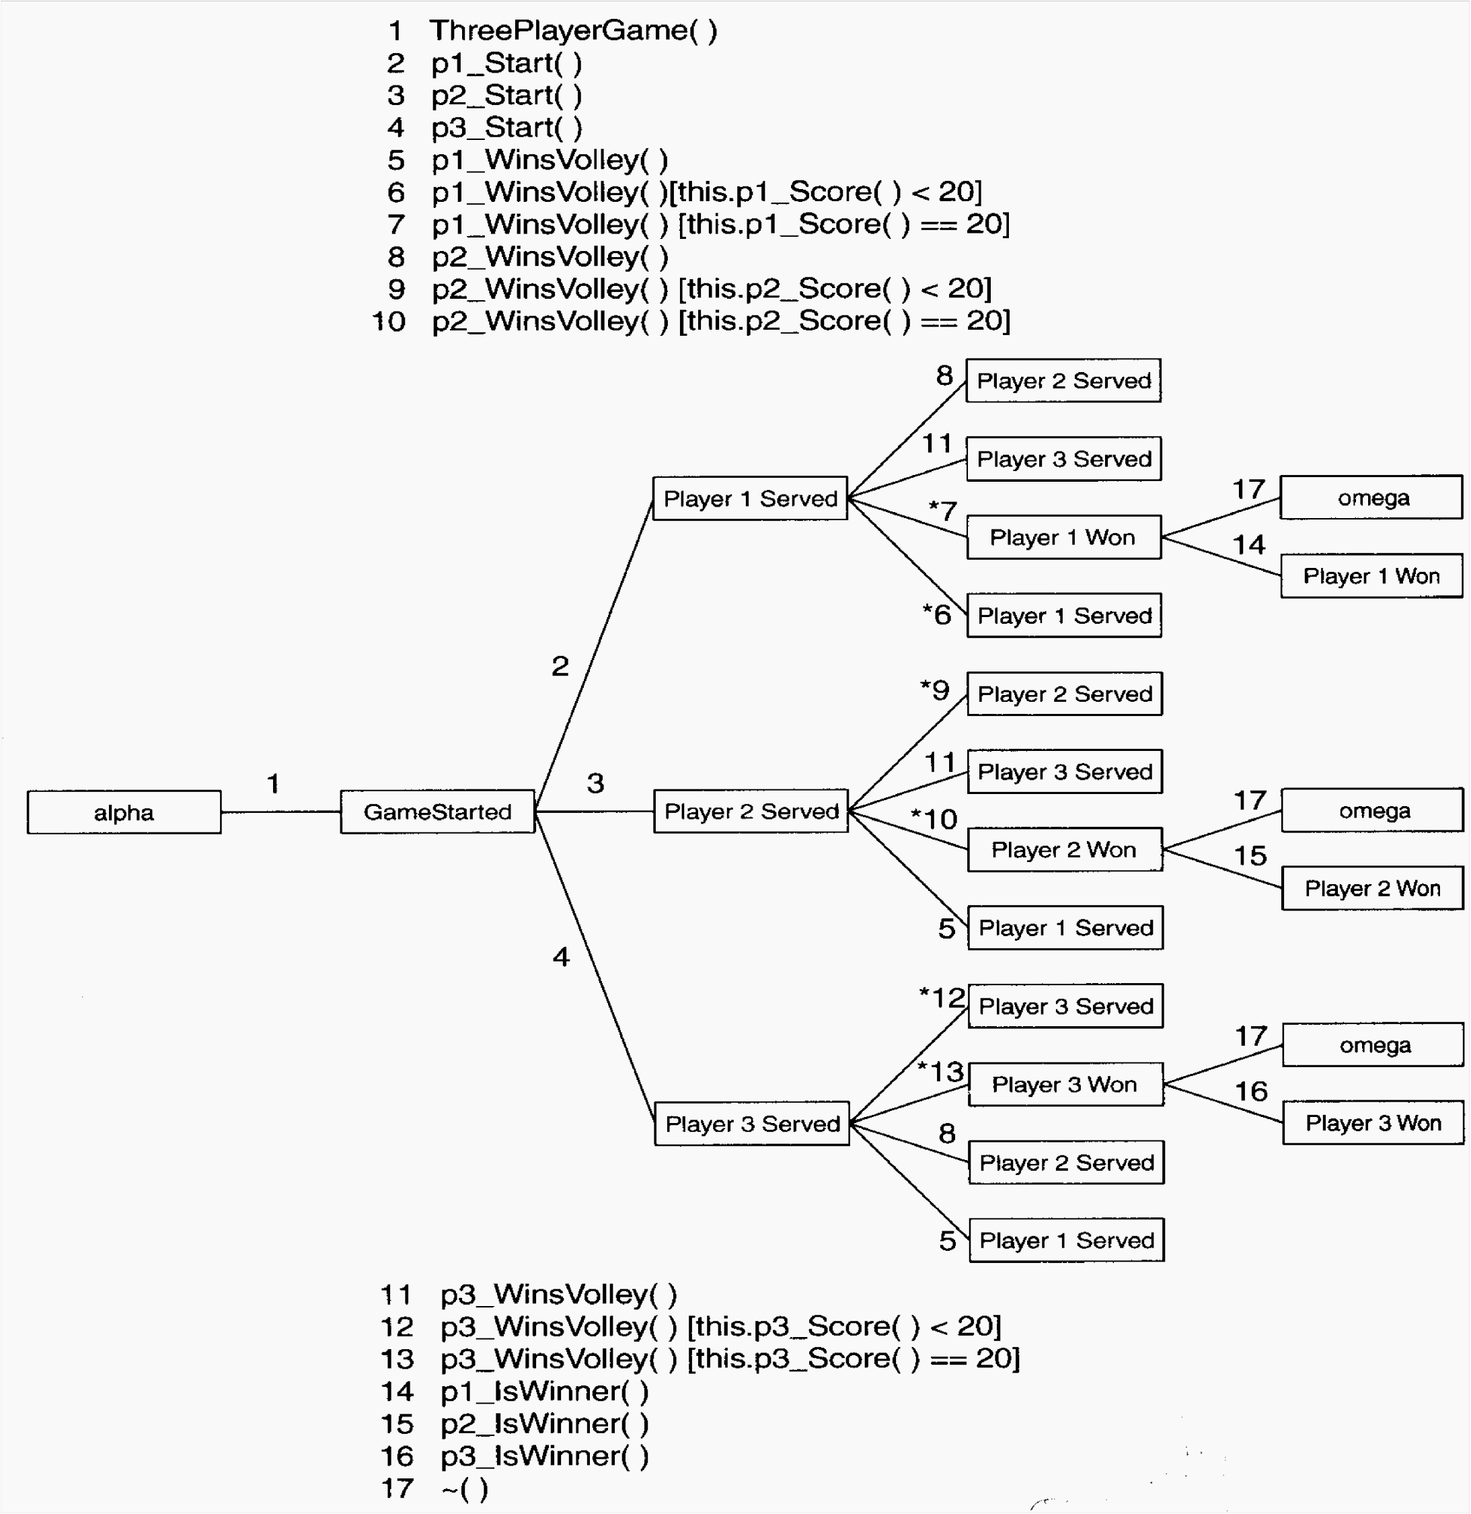
Tree

Slide 40
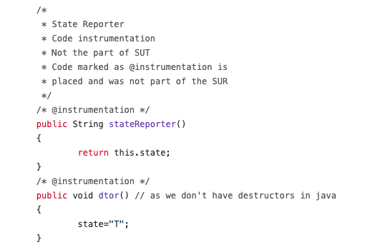
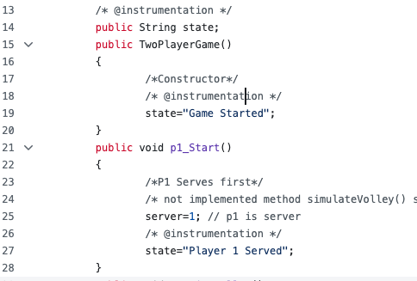
SUT Instrumentation for Automated Test Generation

Slide 41

Activity 2
Generate suites for All Transition (conformance), and Sneak Path test suites in Code Playground
Enhance and submit the generated JUnit4 test coverage.

Slide 42






Evaluation
Activity 1 tests
SUT
Activity 2 tests
State-level mutants

Slide 43
Thank you!
Muhammad Abbas
Senior Forskare
Smart Industrial Automation
muhammad.abbas@ri.se
Mehrdad Saadatmand
Senior Forskare
Smart industrial Automation
mehrdad.saadatmand@ri.se
https://github.com/a66as/StateBasedTestCaseGeneration

